Slide 1
Multi-dimensional Arrays in C

Slide 2
multidimensional array declaration
C programming language allows multidimensional arrays. Here is the general form of a multidimensional array declaration
type name[size1][size2]...[sizeN];
char vowels[1][5] = { {'a', 'e', 'i', 'o', 'u'} };
char vowels[][5] = { {'A', 'E', 'I', 'O', 'U'},
{'a', 'e', 'i', 'o', 'u'} };
For example, the following declaration creates a three dimensional integer array
int threedim[5][10][4];

Slide 3
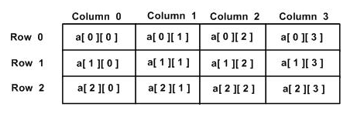
Two-dimensional Arrays
To declare a two-dimensional integer array of size [ x ][ y ],
type arrayName [x][y];
Where type can be any C data type (int, char, long, long long, double, etc.)
arrayName will be a valid C identifier, or variable.
A two-dimensional array can be considered as a table which will have [ x ] number of rows and [ y ] number of columns.
A two-dimensional array a, which contains three rows and four columns.
Every element in the array a is identified by an element name in the form a[i][j], where 'a' is the name of the array, and 'i' and 'j' are the indexes that uniquely identify, or show, each element in 'a‘.

Slide 4
Syntax of a Multi Dimensional Array in C Programming
Data_Type Array_Name[Tables][Row_Size][Column_Size]
Data_type: It will decide the type of elements it will accept. For example, If we want to store integer values then we declare the Data Type as int, If we want to store Float values then we declare the Data Type as float etc
Array_Name: This is the name you want to give it to Multi Dimensional array in C.
Tables: It will decide the number of tables an array can accept. Two Dimensional Array is always a single table with rows and columns. In contrast, Multi Dimensional array in C is more than 1 table with rows and columns.
Row_Size: Number of Row elements an array can store.
Column_Size: Number of Column elements an array can store.
We can calculate the maximum number of elements in a Three Dimensional using: [Tables] * [Row_Size] * [Column_Size].

Slide 5
Example
int Employees[2][4][3];
Here, we used int as the data type to declare an array. So, the above array will accept only integers. If you try to add float values, it throws an error.
Employees is the array name
The number of tables = 2. So, this array will hold a maximum of 2 levels of data (rows and columns).
The Row size of an Array is 4. It means Employees array only accept 4 integer values as rows.
If we try to store more than 4, it throws an error.
We can store less than 4. For Example, If we store 2 integer values, the remaining two will assign with the default value (Which is 0).
The Column size of an Array is 3. It means Employees array will only accept 3 integer values as columns.
If we try to store more than 3, it throws an error.
We can store less than 3. For Example, If we store 1 integer values, the remaining 2 values will assign with the default value (Which is 0).
Finally, Employees array can hold a maximum of 24 integer values (2 * 4 * 3 = 24).

Slide 6
Initializing a multidimensional array
Initialization of a 2d array
// Different ways to initialize two-dimensional array
int c[2][3] = {{1, 3, 0}, {-1, 5, 9}};
int c[][3] = {{1, 3, 0}, {-1, 5, 9}};
int c[2][3] = {1, 3, 0, -1, 5, 9};
Initialization of a 3d array
You can initialize a three-dimensional array in a similar way like a two-dimensional array.
int test[2][3][4] =
{ {{3, 4, 2, 3}, {0, -3, 9, 11}, {23, 12, 23, 2}},
{{13, 4, 56, 3}, {5, 9, 3, 5}, {3, 1, 4, 9}}};

Slide 7
Initializing Two-Dimensional Arrays
Multidimensional arrays may be used by specifying bracketed[] values for each row.
Below is an array with 3 rows and each row has 4 columns.
int a[3][4] ={ {0, 1, 2, 3}, /* initializers for row indexed by 0 */
{4, 5, 6, 7} , /* initializers for row indexed by 1 */
{8, 9, 10, 11} /* initializers for row indexed by 2 */
};
The inside braces, which indicates the wanted row, are optional.
int a[3][4] = {0,1,2,3,4,5,6,7,8,9,10,11};

Slide 8
Initializing Two-Dimensional Arrays
A two dimensional array:
int arr[2][3];
This array has total 2*3 = 6 elements.
A three dimensional array:
int arr[2][2][2];
This array has total 2*2*2 = 8 elements.

Slide 9
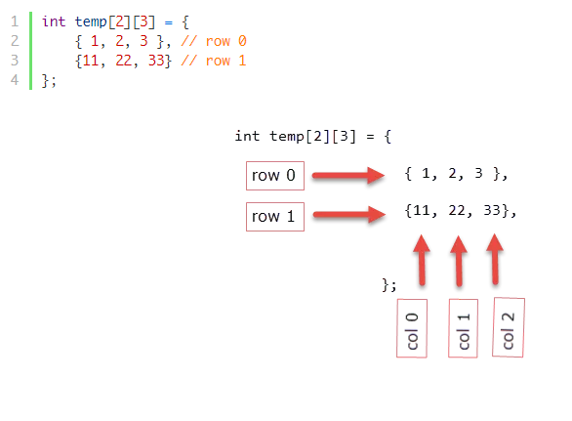
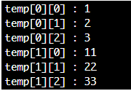
Initialization of 2D Array

Slide 10
Initialization of 2D Array
There are two ways to initialize a two Dimensional arrays during declaration.
int disp[2][4] =
{
{10, 11, 12, 13},
{14, 15, 16, 17}
};
int disp[2][4] = { 10, 11, 12, 13, 14, 15, 16, 17};
/* Valid declaration*/
int abc[2][2] = {1, 2, 3 ,4 }
/* Valid declaration*/
int abc[ ][2] = {1, 2, 3 ,4 }
/* Invalid declaration – you must specify second dimension*/
int abc[ ][ ] = {1, 2, 3 ,4 }
/* Invalid because of the same reason mentioned above*/
int abc[2][ ] = {1, 2, 3 ,4 }

Slide 11
Array declaration, initialization and accessing | Example
Array declaration syntax: data_type arr_name [num_of_rows][num_of_column]; Array initialization syntax: data_type arr_name[2][2] = {{0,0},{0,1},{1,0},{1,1}}; Array accessing syntax: arr_name[index]; | Integer array example: int arr[2][2]; int arr[2][2] = {1,2, 3, 4}; arr [0] [0] = 1; arr [0] ]1] = 2; arr [1][0] = 3; arr [1] [1] = 4;

Slide 12
How is a[i] == i[a]?
Compilers use pointer arithmetic internally to access array elements. And because of the conversion rules that apply to the binary + operator, if E1 is an array object (equivalently, a pointer to the initial element of an array object) and E2 is an integer, E1[E2] designates the E2-th element of E1 (counting from zero).
Therefore, a[b] is defined as : a[b] == *(a + b)
Similarly, a[8] == *(a + 8) Here, a is a pointer to the first element of the array and a[8] is the value of an elements which is 8 elements further from a, which is the same as *(a + 8) and 8[a] will evaluate to following which means both are same.
8[a] == *(8 + a) So by addition commutative property, a[8] == 8[a]

Slide 13
Structures

Slide 14
What is a structure?
A structure is a user defined data type in C. A structure creates a data type that can be used to group items of possibly different types into a single type.

Slide 15
How to define structures?
Before you can create structure variables, you need to define its data type. To define a struct, the struct keyword is used.
Syntax of struct :
struct structureName
{
dataType member1;
dataType member2;
...
};

Slide 16
Here is an example:
struct Person
{
char name[50];
int citNo;
float salary;
};
Here, a derived type struct Person is defined. Now, you can create variables of this type.

Slide 17
Create struct variables
When a struct type is declared, no storage or memory is allocated. To allocate memory of a given structure type and work with it, we need to create variables.
Here's how we create structure variables:
One way :

Slide 18
struct Person
{
char name[50];
int citNo;
float salary;
};
int main()
{
struct Person person1, person2, p[20];
return 0;
}

Slide 19
Another way
struct Person
{
char name[50];
int citNo;
float salary;
} person1, person2, p[20];
In both the cases 2 variables person1, person2 is created and an array of p having 20 element of type struct Person will be created.

Slide 20
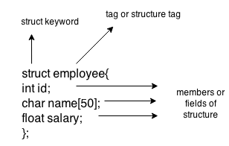
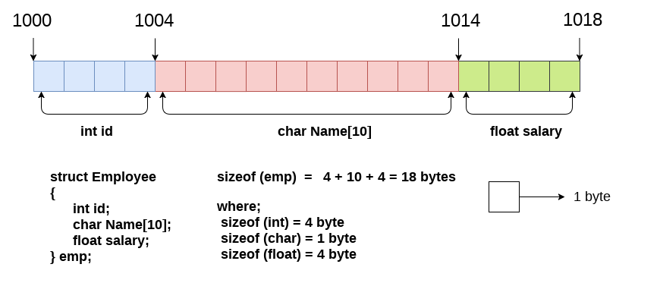

Slide 21
How to initialize structure members?
Structure members cannot be initialized with declaration. For example the following C program fails in compilation.
struct Point
{
int x = 0; // COMPILER ERROR: cannot initialize members here
int y = 0; // COMPILER ERROR: cannot initialize members here
};
The reason for above error is simple, when a datatype is declared, no memory is allocated for it. Memory is allocated only when variables are created.

Slide 22
How to initialize structure members?
Structure members can be initialized using curly braces ‘{}’. For example, following is a valid initialization.
struct Point
{
int x, y;
};
int main()
{
// A valid initialization. member x gets value 0 and y
// gets value 1. The order of declaration is followed.
struct Point p1 = {0, 1};
}

Slide 23
Accessing Structure Members
To access any member of a structure, we use the member access operator (.). The member access operator is coded as a period between the structure variable name and the structure member that we wish to access. You would use the keyword struct to define variables of structure type.

Slide 24
Always use strcpy to assign a string value to a string variable.
The reason for this is that in C, we cannot equate two strings (i.e. character arrays). If we had written ' p1.name="Brown"; ', that would have given an error. Therefore, by writing strcpy(p1,"Brown"), we are copying the string 'Brown' to the string variable p1.name.
struct student p1 = {1,"Brown",123443}; → This is also one of the ways in which we can initialize a structure. In next line, we are just giving values to the variables and printing it.

Slide 25
Pointers to Structures
Like we have pointers for int, char and other data-types, we also have pointers pointing to structures. These pointers are called structure pointers.
struct structure_name { data-type member-1; data-type member-1; data-type member-1; data-type member-1; }; main() { struct structure_name *ptr }

Slide 26
#include <stdio.h>
int main()
{
struct student
{
char name[30];
int roll_no;
};
struct student stud = {"sam",1};
struct student *ptr;
ptr = &stud;
printf("%s %d\n",stud.name,stud.roll_no);
printf("%s %d\n",ptr->name,ptr->roll_no);
return 0;
}

Slide 27
ptr = &stud; → We are making our pointer 'ptr' to point to structure 'stud’.
This was the same thing that we have done earlier up till here. Now, coming to printf.
printf("%s %d\n",ptr->name,ptr->roll_no); → Yes, we use -> to access a structure from its pointer.
It is same as we were using (.) with structure, we use -> with pointer.

Slide 28
Nested Structures
C provides us the feature of nesting one structure within another structure by using which, complex data types are created. For example, we may need to store the address of an entity employee in a structure. The attribute address may also have the subparts as street number, city, state, and pin code. Hence, to store the address of the employee, we need to store the address of the employee into a separate structure and nest the structure address into the structure employee.
When a structure definition has an object of another structure, it is known as Nested Structure.

Slide 29
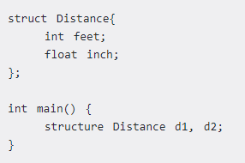
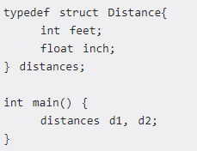
Keyword typedef
We use the typedef keyword to create an alias name for data types.
It is commonly used with structures to simplify the syntax of declaring variables.

Slide 30
Using normal variable | Using pointer variable
Syntax: struct tag_name { data type var_name1; data type var_name2; data type var_name3; }; | Syntax: struct tag_name { data type var_name1; data type var_name2; data type var_name3; };
Example: struct student { int mark; char name[10]; float average; }; | Example: struct student { int mark; char name[10]; float average; };

Slide 31
Using normal variable | Using pointer variable
Declaring structure using normal variable: struct student report; | Declaring structure using pointer variable: struct student *report, rep;
Initializing structure using normal variable: struct student report = {100, “Mani”, 99.5}; | Initializing structure using pointer variable: struct student rep = {100, “Mani”, 99.5}; report = &rep;
Accessing structure members using normal variable: report.mark; report.name; report.average; | Accessing structure members using pointer variable: report -> mark; report -> name; report -> average;

Slide 32
Dynamic Memory Allocation in C

Slide 33
MEMORY ALLOCATION
The blocks of information in a memory system is called memory allocation.
To allocate memory it is necessary to keep in information of available memory in the system.
If memory management system finds sufficient free memory, it allocates only as much memory as needed, keeping the rest available to satisfy future request.
In memory allocation has two types. They are
Static memory allocation.
Dynamic memory allocation.

Slide 34
MEMORY ALLOCATION
STATIC MEMORY ALLOCATION
In static memory allocation, size of the memory may be required for the that must be define before loading and executing the program.
DYNAMIC MEMORY ALLOCATION
In the dynamic memory allocation, the memory is allocated to a variable or program at the run time.
The only way to access this dynamically allocated memory is through pointer.

Slide 35
What is a Stack?
A stack is a special area of computer's memory which stores temporary variables created by a function. In stack, variables are declared, stored and initialized during runtime.
It is a temporary storage memory. When the computing task is complete, the memory of the variable will be automatically erased. The stack section mostly contains methods, local variable, and reference variables.

Slide 36
What is Heap?
The heap is a memory used by programming languages to store global variables. By default, all global variable are stored in heap memory space. It supports Dynamic memory allocation.
The heap is not managed automatically for you and is not as tightly managed by the CPU. It is more like a free-floating region of memory.

Slide 37
When to use the Heap or stack?
You should use heap when you require to allocate a large block of memory. For example, you want to create a large size array or big structure to keep that variable around a long time then you should allocate it on the heap.
However, If you are working with relatively small variables that are only required until the function using them is alive. Then you need to use the stack, which is faster and easier.

Slide 38
KEY DIFFERENCE
Stack is a linear data structure whereas Heap is a hierarchical data structure.
Stack memory will never become fragmented whereas Heap memory can become fragmented as blocks of memory are first allocated and then freed.
Stack accesses local variables only while Heap allows you to access variables globally.
Stack variables can’t be resized whereas Heap variables can be resized.
Stack memory is allocated in a contiguous block whereas Heap memory is allocated in any random order.
Stack doesn’t require to de-allocate variables whereas in Heap de-allocation is needed.
Stack allocation and deallocation are done by compiler instructions whereas Heap allocation and deallocation is done by the programmer.

Slide 39
Why dynamic memory allocation?
Usually, so far, the arrays and strings we’re using have fixed length (i.e., length is known at compile time)
Example:
char myStr[ ] 11 ; // allocates memory for 10 chars printf(“Enter a string:\n” );
scanf(“%s”, myStr);
What if the user wants to enter a string more than 10 chars long or if the length is known only at run time?

Slide 40
C Dynamic Memory Allocation
An array is a collection of a fixed number of values. Once the size of an array is declared, you cannot change it.
Sometimes the size of the array you declared may be insufficient. To solve this issue, you can allocate memory manually during run-time. This is known as dynamic memory allocation in C programming.
To allocate memory dynamically, library functions are malloc(), calloc(), realloc() and free() are used.
These functions are defined in the <stdlib.h> header file.

Slide 41
difference between static memory allocation and dynamic memory allocation.
static memory allocation | dynamic memory allocation
memory is allocated at compile time. | memory is allocated at run time.
memory can't be increased while executing program. | memory can be increased while executing program.
used in array. | used in linked list.

Slide 42
Static vs Dynamic Memory Allocation
Static memory allocation is a method of allocating memory, and once the memory is allocated, it is fixed. | Dynamic memory allocation is a method of allocating memory, and once the memory is allocated, it can be changed.
Modification
In static memory allocation, it is not possible to resize after initial allocation. | In dynamic memory allocation, the memory can be minimized or maximize accordingly.
Implementation
Static memory allocation is easy to implement. | Dynamic memory allocation is complex to implement.
Speed
In static memory, allocation execution is faster than dynamic memory allocation. | In dynamic memory, allocation execution is slower than static memory allocation.
Memory Utilization
In static memory allocation, cannot reuse the unused memory. | Dynamic memory allocation allows reusing the memory. The programmer can allocate more memory when required .He can release the memory when necessary.

Slide 43
methods used for dynamic memory allocation
malloc() | Allocates the memory of requested size and returns the pointer to the first byte of allocated space.
calloc() | Allocates the space for elements of an array. Initializes the elements to zero and returns a pointer to the memory.
realloc() | It is used to modify the size of previously allocated memory space.It reallocates the memory occupied by malloc() or calloc() functions.
free() | frees the dynamically allocated memory.

Slide 44
C malloc()
The name "malloc" stands for memory allocation.
The malloc() function reserves a block of memory of the specified number of bytes.
The malloc() function allocates single block of requested memory.
It doesn't initialize memory at execution time, so it has garbage value initially.
It returns a pointer of void which can be casted into pointers of any form.
Syntax of malloc()
ptr = (castType*) malloc(size);
Example : ptr = (float*) malloc(100 * sizeof(float));

Slide 45
C malloc()
Syntax of malloc()
ptr = (castType*) malloc(size);
Example : ptr = (float*) malloc(100 * sizeof(float));
The above statement allocates 400 bytes of memory. It's because the size of float is 4 bytes.
Input is the number of consecutive bytes to be allocated.
And, the pointer ptr holds the address of the first byte in the allocated memory.
The expression results in a NULL pointer if the memory cannot be allocated.
To use malloc(), you must #include<stdlib.h>.

Slide 46
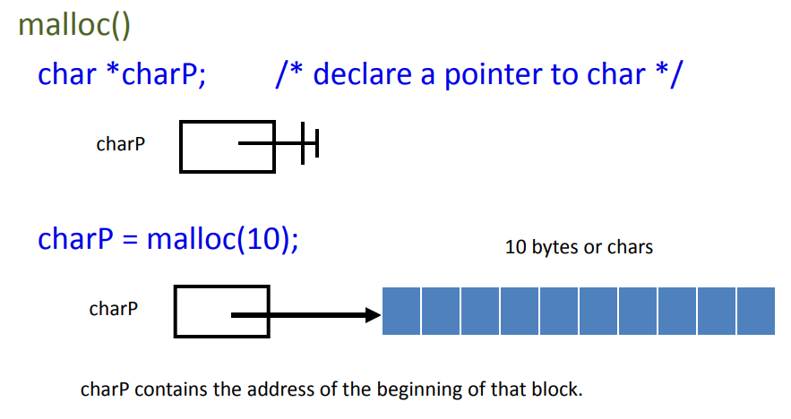
C malloc()

Slide 47
malloc allocates bytes
If you want a character array that stores 10 characters (including ‘\0’):
char *p = malloc(10);
If you want to allocate storage for 10 ints (or doubles or floats), you can’t do this:
int *p = malloc(10); /* WRONG! Why? */

Slide 48
allocate int and double array
int *intP;
double *doubleP;
// Allocate space for 10 integers
intP = malloc(10 * sizeof(int));
// Allocates 40 bytes, sizeof(int) = 4
// Allocate space for 10
doubles doubleP = malloc(10 * sizeof(double));
// Allocates 80 bytes, sizeof(double) = 8

Slide 49
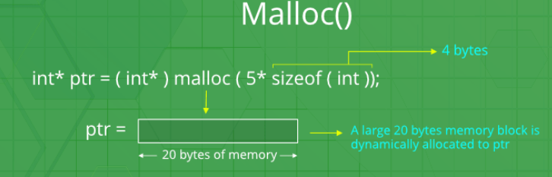

Slide 50
C calloc()
The name "calloc" stands for contiguous allocation.
The malloc() function allocates memory and leaves the memory uninitialized. Whereas, the calloc() function allocates memory and initializes all bits to zero.
It returns NULL if memory is not sufficient.
Syntax of calloc()
ptr = (castType*)calloc(n, size);
Example: ptr = (float*) calloc(25, sizeof(float));
The above statement allocates contiguous space in memory for 25 elements of type float.

Slide 51
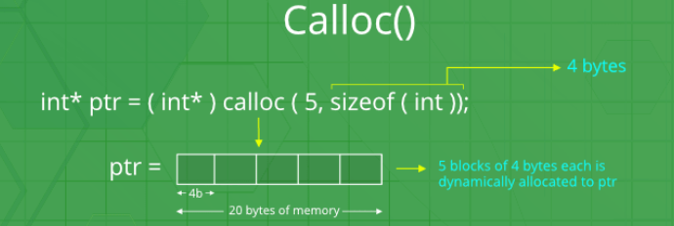

Slide 52
C free()
Dynamically allocated memory created with either calloc() or malloc() doesn't get freed on their own.
You must explicitly use free() to release the space.
Syntax of free()
free(ptr);
where ptr “points to” memory previously previously allocated allocated by malloc() function .
This statement frees the space allocated in the memory pointed by ptr.

Slide 53
C realloc()
If the dynamically allocated memory is insufficient or more than required, you can change the size of previously allocated memory using the realloc() function.
Syntax of realloc()
ptr = realloc(ptr, x);
Here, ptr is reallocated with a new size x.
If memory is not sufficient for malloc() or calloc(), you can reallocate the memory by realloc() function. In short, it changes the memory size.

Slide 54
C realloc()
realloc takes a pointer to allocated memory and reallocates the memory to a larger size.
If it can make the old block bigger, great.
If not, it will get another, larger block, copy the old contents contents to the new contents contents, free the old contents contents and return a pointer to the new.
intP = malloc(sizeof(int));
intP = realloc(intP, 2*sizeof(intP));
intP may be different after a realloc!

Slide 55
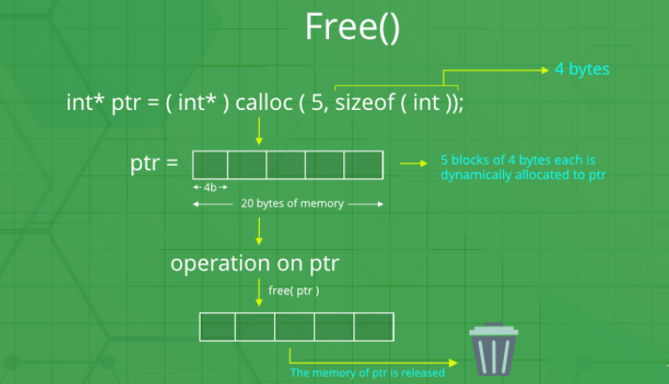

Slide 56
calloc vs. malloc: Differences
The calloc function is generally more suitable and efficient than that of the malloc function.
While both the functions are used to allocate memory space, calloc can allocate multiple blocks at a single time. You don't have to request for a memory block every time.
The calloc function is used in complex data structures which require larger memory space.
The memory block allocated by a calloc function is always initialized to zero while in malloc it always contains a garbage value.

Slide 57
calloc vs. malloc: Differences
malloc() | calloc()
int *ptr; ptr = malloc( 20 * sizeof(int) ); For the above, 20*4 bytes of memory only allocated in one block. Total = 80 bytes | int *ptr; Ptr = calloc( 20, 20 * sizeof(int) ); For the above, 20 blocks of memory will be created and each contains 20*4 bytes of memory. Total = 1600 bytes
malloc () doesn’t initializes the allocated memory. It contains garbage values | calloc () initializes the allocated memory to zero
type cast must be done since this function returns void pointer int *ptr; ptr = (int*)malloc(sizeof(int)*20 ); | Same as malloc () function int *ptr;ptr = (int*)calloc( 20, 20 * sizeof(int) );

Slide 58
Memory leak
Memory leaks refer to memory that has been allocated by an application, but not properly released back once that memory is no longer needed.
Many systems have multiple applications running on their systems and programming errors usually result in “memory leaks”.
Memory leaks may not affect the functionality of the application, but left unattended in a system, memory leaks can cause the machine to crash.
This is why, servers restart often to avoid them to from going down. Programmers typically allocate memory and then somehow may lose the reference to that memory block.

Slide 59
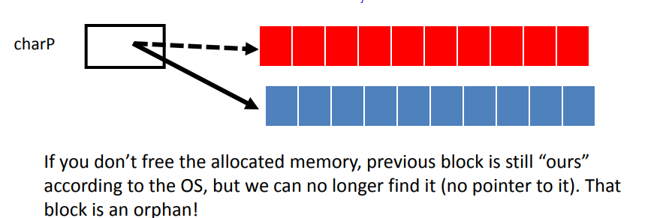
Memory leak
If malloc’ed memory is not free’ed, then the OS will “leak memory”
This means that memory is allocated to the program but not returned to the OS when it is finished using it
The program program therefore therefore grows larger over time and eventually runs out of memory!

Slide 60
Advantages of Dynamic memory allocation
Data structures can grow and shrink according to the requirement.
We can allocate (create) additional storage whenever we need them.
We can de-allocate (free/delete) dynamic space whenever we are done with them.
Dynamic Allocation is done at run time.
Disadvantages of Dynamic memory allocation
As the memory is allocated during runtime, it requires more time.
Memory needs to be freed by the user when done. This is important as it is more likely to turn into bugs that are difficult to find.

Slide 61
Summary
We can dynamically manage memory by creating memory blocks as needed in the heap
In dynamic memory allocation, memory is allocated at a run time.
Dynamic memory allocation permits to manipulate strings and arrays whose size is flexible and can be changed anytime in your program.
It is required when you have no idea how much memory a particular structure is going to occupy.
Malloc is a dynamic memory allocation function which stands for memory allocation that blocks of memory with the specific size initialized to a garbage value
Calloc is a contiguous memory allocation function that allocates multiple memory blocks at a time initialized to 0
Realloc is used to reallocate memory according to the specified size.
Free function is used to clear the dynamically allocated memory.

